Slide 1
Common pediatric surgical problems
Dr Kalkidan A.

Slide 2
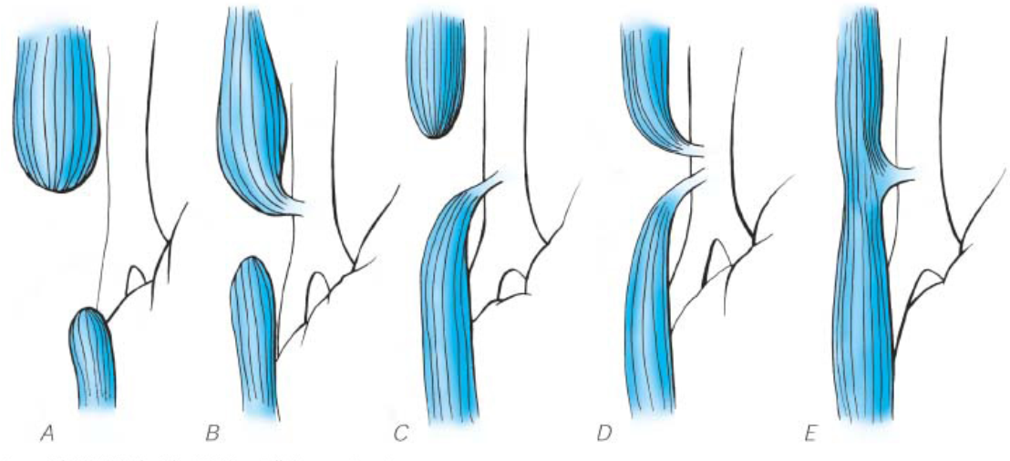
Esophageal Atresia and Tracheoesophageal Fistula
H - type
8 to 10%
~1%
75–85%
1–2%
5–8%

Slide 3
Embryology
The esophagus and trachea share a common embryologic origin
They typically divide into separate tubes by approximately the 36th day of gestation
Failure of this occurrence can result in the spectrum of anomalies

Slide 4
Clinical Presentation
Excessive drooling, followed by choking or coughing immediately after feeding
As a result, aspiration occurs through the fistula tract
As the neonate coughs and cries, air is transmitted through the fistula into the stomach, resulting in abdominal distention

Slide 5
Diagnosis
confirmed by the inability to pass an orogastric tube into the stomach
The tube will coil in the upper pouch, which provides further diagnostic certainty
The presence of a TEF can be demonstrated clinically by finding air in the GIT (Percussion or plain abdominal film)

Slide 6
Management
place the neonate in an infant warmer with the head elevated at least 30 degrees
A sump catheter is placed in the upper pouch on continuous suction
Intravenous antibiotic therapy is initiated
The timing of repair is influenced by the stability of the patient
Definitive repair of the EA-TEF is rarely a surgical emergency
If the child is hemodynamically stable and is oxygenating well, definitive repair may be performed within 1 to 2 days after birth

Slide 7
Hypertrophic Pyloric Stenosis
Classically presents in a first-born male between 3 and 6 weeks of age
present with projectile nonbilious vomiting
physical examination- palpate "olive" shaped mass in the right upper quadrant, and the presence of visible gastric waves on the abdomen
develop a hypochloremic, hypokalemic metabolic alkalosis

Slide 8
Investigation
Ultrasound can diagnose the condition accurately in 95% of patients
Criteria for ultrasound diagnosis include a channel length of over 16 mm and pyloric thickness over 4 mm

Slide 9
Treatment
Fluid resuscitation with correction of electrolyte abnormalities and metabolic alkalosis is essential before induction of general anesthesia for surgery
After resuscitation, a Fredet-Ramstedt pyloromyotomy is performed

Slide 10
Intestinal obstruction
The cardinal symptom of intestinal obstruction in the newborn is bilious emesis
Intestinal obstruction can be proximal or distal to the ligament of Treitz
Proximal obstruction presents as bilious vomiting, with minimal abdominal distention
Distal obstruction presents with abdominal distention and bilious emesis
In all cases of intestinal obstruction, it is vital to obtain abdominal films in the supine and upright (lateral decubitus) views
This is the only way to assess the presence of air-fluid levels or free air, and to characterize the obstruction as proximal or distal

Slide 11
Duodenal Obstruction
In 85% of infants with duodenal obstruction, the entry of the bile duct is proximal to the level of obstruction, such that vomiting is bilious
Abdominal distention is typically not present because of the proximal level of obstruction

Slide 12
Cont.
Duodenal obstruction is easily diagnosed on prenatal ultrasound, which demonstrates the fluid-filled stomach and proximal duodenum as two discrete cystic structures in the upper abdomen
The classic finding on abdominal radiography is the "double bubble" sign, which represents the dilated stomach and duodenum

Slide 13
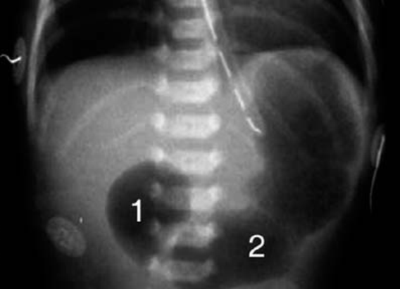
“Double bubble" sign

Slide 14
Treatment
An orogastric tube is inserted to decompress the stomach and duodenum and the infant is given IV fluids to maintain adequate urine output
The infant should be evaluated thoroughly for other associated anomalies
Approximately one-third of newborns with duodenal atresia have associated Down syndrome

Slide 15
Cont.
The surgical treatment of choice for duodenal obstruction due to duodenal stenosis or atresia or annular pancreas is a duodenoduodenostomy
An annular pancreas is never divided
Treatment of duodenal web includes vertical duodenotomy, excision of the web, oversewing of the mucosa, and closing the duodenotomy horizontally

Slide 16
Hirschsprung's Disease
caused by a malformation in the pelvic parasympathetic system which results in the absence of ganglion cells in Auerbach's plexus of a segment of distal colon.
In the newborn period, the most common symptoms are abdominal distention, failure to pass meconium, and bilious emesis
Any infant who does not pass meconium beyond 48 hours of life must be investigated for the presence of Hirschsprung's disease

Slide 17
Cont.
On rectal examination, forceful propulsion of foul-smelling liquid feces is typically observed,
20% of cases, the diagnosis of Hirschsprung's disease is made beyond the newborn period
These children have severe constipation,

Slide 18
Diagnosis
The definitive diagnosis of Hirschsprung's disease is made by rectal biopsy
Barium enema show location of the transition zone between the dilated ganglionic colon and the distal constricted aganglionic rectal segment

Slide 19
Treatment
The diagnosis of Hirschsprung's disease requires surgery in all cases
The classic surgical approach consists of a multiple stage procedure
colostomy in the newborn period, followed by a definitive pull-through operation after the child weighed over 10 kg
Recently it has been shown that a primary pull-through procedure can be performed safely, even in the newborn period
There is no upper age limit for performing a primary pull-through

Slide 20
Intussusception
It is the leading cause of intestinal obstruction in the young child
It refers to the condition whereby a segment of intestine becomes drawn into the lumen of the more proximal bowel
The cause is hypertrophy of the Peyer's patches in the terminal ileum from an antecedent viral infection (usually a GI viral illness) acts as the starting point
Peristaltic action of the intestine then causes the bowel distal to this point to invaginate into itself

Slide 21
Cont.
Idiopathic intussusception occurs in children between the ages of approximately 6 and 24 months
Beyond this age group, one should consider the possibility that a pathologic starting point may be present
These include polyps, malignant tumors such as lymphoma, enteric duplication cysts, or Meckel's diverticulum

Slide 22
Clinical manifestation
Typically, the infant develops paroxysms of crampy abdominal pain and intermittent vomiting
Between attacks, the infant may act normally, but as symptoms progress, increasing lethargy develops
Bloody mucus ("currant-jelly" stool) may be passed per rectum

Slide 23
Cont.
On physical examination, an elongated mass is detected in the right upper quadrant or epigastrium, with an absence of bowel in the right lower quadrant (Dance's sign)
The mass may be seen on plain abdominal x-ray, but is more easily demonstrated on air or contrast enema

Slide 24
Treatment
Following resuscitation and administration of intravenous antibiotics, the child is assessed for suitability to proceed with radiographic versus surgical reduction
In the absence of peritonitis, the child should undergo radiographic reduction (pneumatic or hydrostatic)
The overall success rate varies based on the experience of the center, and is typically between 60 and 90%
If peritonitis is present, or if the child appears systemically ill, urgent laparotomy is indicated

Slide 25
Cont.
Surgery
Open
RLQ incision
Delivering intussuscepted mass
Reduction or resection depending on the viability of the bowel
Appendectomy is done
The blood supply to the appendix often is compromised
Laparascopy

Slide 26
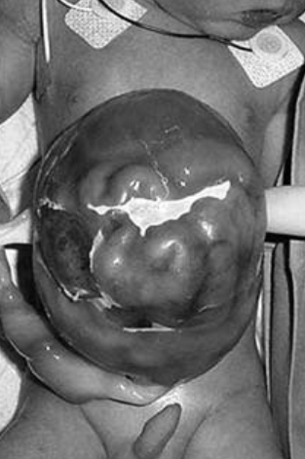
Omphalocele

Slide 27
Cont.
It refers to a congenital defect of the abdominal wall in which the bowel and solid viscera are covered by peritoneum and amniotic membrane
The umbilical cord inserts into the sac
The abdominal wall defect can measure 4 cm or more in diameter
There is a 60 to 70% incidence of associated anomalies, especially cardiac (20 to 40% of cases) and chromosomal abnormalities
Chromosomal anomalies are more common in children with smaller defects
Omphalocele is associated with prematurity (10 to 50% of cases) and IUGR(20%)

Slide 28
Management
The omphalocele should be covered with saline-soaked gauze and the trunk should be wrapped circumferentially
Whenever possible, a primary repair of the omphalocele should be undertaken
This involves resection of the omphalocele membrane and closure of the fascia
In cases where repair could be difficult, like in a case of a giant omphalocele (defect >7 cm in diameter) or associated severe congenital anomalies, a nonoperative approach can be used
The omphalocele sac can be treated with desiccating substances such as povidone-iodine
It typically takes 2 to 3 months before reepithelialization occurs

Slide 29
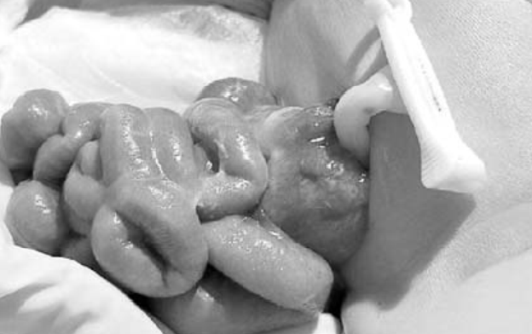
Gastroschisis

Slide 30
Cont.
It represents a congenital defect characterized by a defect in the anterior abdominal wall through which the intestinal contents freely protrude
The intestine may be normal in appearance or more commonly, it could be thick, edematous, discolored, and covered with exudate
Unlike the omphalocele:
There is no overlying sac
The size of the defect is much smaller (<4 cm)
The abdominal wall defect is located at the junction of the umbilicus and normal skin, and is almost always to the right of the umbilicus
Associated anomalies seen with gastroschisis consist mostly of intestinal atresia

Slide 31
Management
All infants born with gastroschisis require urgent surgical treatment
In many instances, the intestine can be returned to the abdominal cavity, and a primary surgical closure of the abdominal wall is performed
In infants whose intestine has become thickened and edematous, it may be impossible to reduce the bowel into the peritoneal cavity in the immediate postnatal period
plastic spring-loaded silo can be placed onto the bowel and secured beneath the fascia
Surgical closure can usually be accomplished within approximately 1 week

Slide 32
Umbilical Hernia
Failure of the umbilical ring to close results in a central defect in the linea alba
Hernias less than 1 cm in size at the time of birth usually will close spontaneously by 4 years of age
Sometimes the hernia is large enough that the protrusion is disfiguring and disturbing to both the child and the family
In such circumstances early repair may be advisable

Slide 33
Management
Incarcerated hernia
Immediate exploration and repair of the hernia
If the child is asymptomatic, the treatment is governed by:
The size of the defect
The age of the patient, and
The concern that the child and family have regarding the cosmetic appearance of the abdomen

Slide 34
Cont.
When the defect is small and spontaneous closure is likely, most surgeons will delay surgical correction until 4 or 5 years of age
If closure does not occur by this time, it is reasonable to repair the hernia
If a younger child has an extremely large hernia, or if the family or child is bothered by the cosmetic appearance, then repair is indicated

Slide 35
Inguinal hernia
It results from a failure of closure of the processus vaginalis, communication persists between the peritoneal cavity and the groin, resulting in a hernia
Inguinal hernias occur more commonly in males than females (10:1), and are more common on the right side than the left
Patients most commonly present with a groin bulge that is noticed by the parents as they change the diaper

Slide 36
Treatment
Usually an incarcerated hernia can be reduced
Following reduction the child may be admitted for observation, and herniorrhaphy is performed within the next 24 hours to prevent recurrent incarceration
If the hernia cannot be reduced, or if evidence of strangulation is present, emergency surgery is necessary
This may require a laparotomy and bowel resection

Slide 37
Cont.
When the diagnosis of inguinal hernia is made in an otherwise normal child, operative repair (Herniorrhaphy) should be planned
Spontaneous resolution does not occur and therefore a nonoperative approach can never be justified

Slide 38
Undescended Testis
The term undescended testicle (cryptorchidism) refers to the interruption of the normal descent of the testis into the scrotum
The testicle may reside in the retroperineum, in the internal inguinal ring, in the inguinal canal, or even at the external ring
The incidence of undescended testes is approximately 30% in preterm infants, and 1 to 3% at term

Slide 39
Clinical presentation
For diagnosis, the child should be examined in the supine position, where visual inspection may reveal a hypoplastic or poorly rugated scrotum
A unilateral undescended testicle usually can be palpated in the inguinal canal or in the upper scrotum
Occasionally, the testicle will be difficult or impossible to palpate, indicating either an abdominal testicle or congenital absence of the gonad
If the testicle is not palpable in the supine position, the child should be examined with his legs crossed while seated
This maneuver diminishes the cremasteric reflex and facilitates identification of the location of the testicle

Slide 40
Treatment
Orchidopexy
Reasons for orchidopexy
Risk of malignant degeneration
Risk is still there after orchidopexy
Risk of infertility
Risk of testicular trauma
Risk of torsion
Psychologic impact of an empty scrotum in a developing male
An inguinal hernia often accompanies a cryptorchid testis
This should be repaired at the time of orchidopexy

Slide 41
Foreign Bodies

Slide 42
Airway Ingestion
Aspiration of foreign bodies most commonly occurs in toddlers
Peanuts are the most common object that is aspirated
A solid foreign body often will cause air trapping, with hyperlucency of the affected lobe or lung seen especially on expiration
Oil from a peanut is irritating and may cause pneumonia
Delay in diagnosis can lead to atelectasis and infection
The most common anatomic location for a foreign body is the right main stem bronchus or the right lower lobe

Slide 43
Cont.
The child usually will cough or choke while eating, but may then become asymptomatic
A unilateral wheeze is often heard on auscultation
Dx and Tx:
CXR will show a radiopaque foreign body, but in the case of nuts, seeds, or plastic toy parts, the only clue may be nondeflation of the affected lobe on an expiratory film or fluoroscopy
Bronchoscopy confirms the diagnosis and allows removal of the foreign body

Slide 44
Esophagus Ingestion
The most common foreign body found in the esophagus is a coin, followed by small toy parts
Toddlers are most commonly affected
The coin is retained in the esophagus at one of three locations:
The cricopharyngeus
The area of the aortic arch
The gastroesophageal junction
Presentation
Symptoms are variable depending on the anatomic position of the foreign body and the degree of obstruction
There is often a relatively asymptomatic period after ingestion

Slide 45
Cont.
Cont.
The initial symptoms are gastrointestinal and include dysphagia, drooling, and vomiting
The longer the foreign body remains in the esophagus, the greater the incidence of respiratory symptoms, which include cough, stridor, and wheezing
These findings may be interpreted as signs of upper respiratory infections
Objects that are present for a long period of time—particularly in children who have underlying neurologic impairment—may manifest as chronic dysphagia

Slide 46
Cont.
Dx:
CXR is diagnostic in the case of a coin
A contrast swallow may be required for nonradiopaque foreign bodies
Tx:
Coins lodged within the upper esophagus for less than 24 hours may be removed using Magill forceps
For all other situations, the treatment is by esophagoscopy, rigid or flexible
Rarely, esophagotomy is required for removal, particularly of sharp objects

Slide 47
The end!

